Slide 1

McGraw-Hill Technology Education
Copyright © 2006 by The McGraw-Hill Companies, Inc. All rights reserved.

Slide 2
Chapter 7B
Survey of PC and Network Operating Systems

Slide 3
PC Operating Systems
Microsoft Windows is the most popular
  Installed more than other OS combined
  Installed on about 95% of computers
  Apple and Linux represent the other 5%
Notes:
Teaching tip
Www.w3schools.com/browsers/browsers_stats.asp provides a neutral look at OS statistics. Refer to this page as you lecture. Visit www.wordiq.com/definition/Microsoft_Windows for an excellent timeline and description of Windows operating systems.

Slide 4
PC Operating Systems
DOS
  Disk Operating System
  Single user single-tasking OS
  Command line interface
  16-bit OS
  Powerful
  Fast
  Supports legacy applications
Notes:
Teaching tip
Students often fail to see the value in older OS or applications. As an example, a metal fabrication plant in Pittsburgh PA is still using a program written in the early 70’s that calculates metal temperatures.

Slide 5
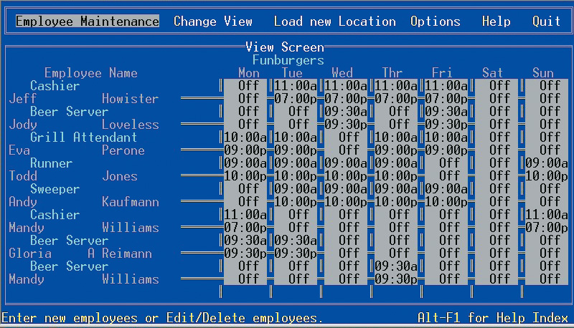
DOS Application

Slide 6
PC Operating Systems
Windows NT
  Designed for a powerful system
  32-bit OS
  Very stable
  Windows NT Workstation
    Single user multi tasking OS
  Windows NT Server
    Multi user multi tasking OS
    Network operating system

Slide 7
PC Operating Systems
Windows 9x
  95, 98, and Millennium Edition (Me)
  32-bit OS
    Supported 16-bit programs well
  Very pretty not stable OS
  Still found in large corporations
  95 introduced the Start button
  98 introduced active desktop
  Me improved multimedia software

Slide 8
PC Operating Systems
Windows 2000
  Look of 9x with NT stability
  Optimized for office and developers
  Application software ran very well
  Entertainment software ran very poorly
Notes:
Discussion point
There are many computer professionals that say that Windows 2000 was the first stable Microsoft product. Engage your class in a discussion regarding a software developer’s obligation to create stable products.

Slide 9
PC Operating Systems
Windows XP
  Microsoft’s newest desktop product
  Different look from 2000
  Many different versions
  Digital multimedia support was enhanced
  Communications was enhanced
  Mobile computing became a priority
Notes:
Teaching tip
At press time, the 64 bit version of XP was still in the late beta stage. More information can be found at www.microsoft.com/presspass/press/2003/sep03/09-23athlon64betapr.asp.

Slide 10
PC Operating Systems
UNIX
  Runs on all computer types
  32- or 64-bit
  Very stable and fast
  Command-line interface
  Can cost thousands of dollars

Slide 11
PC Operating Systems
Linux
  Free or inexpensive version of UNIX
  32-bit OS
  Very stable and fast
  Most flavors are open source
  X Windows GUI
    Command line interface is available

Slide 12
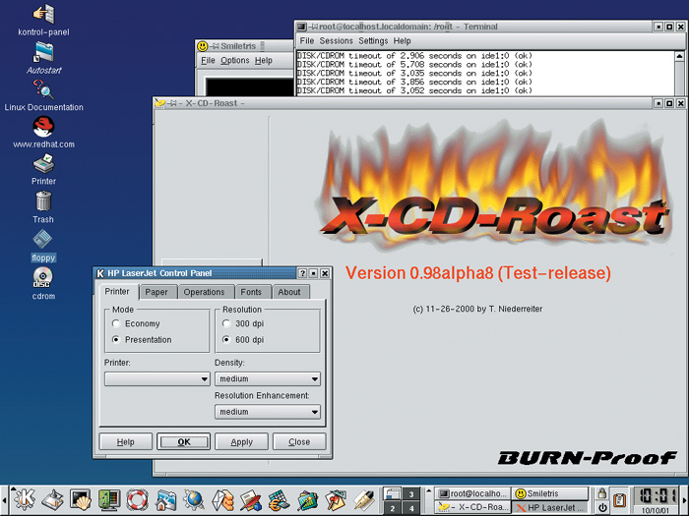
Linux Desktop

Slide 13
PC Operating Systems
Macintosh operating systems
  OS X
  Based on FreeBSD Linux
  Very stable and easy to configure
  Only runs on Mac hardware
Notes:
Teaching tip
OS X versions change often. Keep track of the most current and present this to the class. Visit www.apple.com/macosx/ to keep up to date. At press time the latest version was 10.4 Tiger.

Slide 14
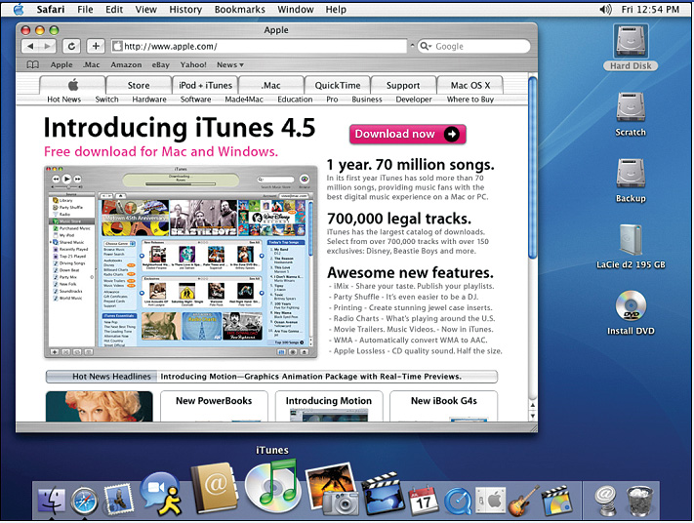
OS X Desktop

Slide 15
NOS Features
Network operating system
Fast and stable
Runs on servers
Multi-user and multitasking OS
32- or 64-bit

Slide 16
NOS Features
File and print sharing
  Users access the same files
  Hundreds of users use a printer
  Different OS can interact

Slide 17
NOS Features
Data integrity
  Backups copies data onto tape
  RAID copies data onto other drives
    Redundant Array of Inexpensive Disks
    Relies on two or more hard drives
    May speed access to data

Slide 18
NOS Features
Data security
  Access to data can be restricted
  Access to server resources is controlled
  Audits can be kept
Notes:
Teaching tip
Tell your students what NOS your school uses.

Slide 19
Networking Operating Systems
NT Server
  Same core as NT Workstation
  Security added
  Multi user capability added
  RAID support included

Slide 20
Networking Operating Systems
Windows 2000 Server
  Same technology as 2000 workstation
  Active Directory (AD)
    Central database of server resources
    Simplifies network management
  Distributed programs supported
  Server Standard Edition
  Advanced Server Edition
  Data Center Edition
Notes:
Teaching tip
Spend some time describing how distributed applications can reduce network needs.

Slide 21
Networking Operating Systems
Windows 2003 Server
  Designed to compete with UNIX
  XP like interface
  Better support for XP computers
  MS .NET framework supported
  Distributed programs are supported
  Server Standard Edition
  Data Center Edition

Slide 22
Networking Operating Systems
UNIX for servers
  Oldest NOS in widespread use
  Stable secure and fast
  Main OS for Internet and Web
  Large organizations depend on UNIX

Slide 23
Networking Operating Systems
Linux for servers
  Popular in small businesses
  Stable, fast and inexpensive
  Linux’s popularity is growing
Notes:
Insider information
The email service hotmail was originally hosted on Linux servers. Microsoft purchased Hotmail and moved it to Windows servers. It took Microsoft nearly a year to make Hotmail work as well on Windows as it did on Linux.

Slide 24
Embedded Operating Systems
Devices have EOS built in
Cell phones, PDAs, medical equipment
Stable and fast

Slide 25
Embedded Operating Systems
Windows XP embedded
  Based on Windows XP
  Customized for each device

Slide 26
Embedded Operating Systems
Windows CE
  Not based on a desktop OS
  Customized for each device
  PDA and cell phones
  Microsoft Automotive will run in cars
Notes:
Teaching tip
Have a little fun with this one. Windows CE has the unfortunate and unofficial shortcut name of WinCE.

Slide 27
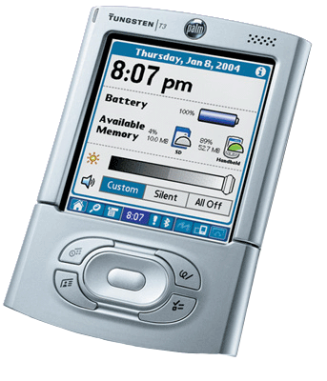
Embedded Operating Systems
Palm OS
  Standard on Palm PDA
  First PDA OS for consumers
  Can be found on cell phones

Slide 28
Embedded Operating Systems
Pocket PC
  Developed to compete with Palm
  Not customizable
  Interacts securely with business networks
  Can control PCs through PC

Slide 29
Embedded Operating Systems
Symbian
  Found in smart cell phones
  Games, Instant Messaging, Internet
  Full color display

Slide 30
Chapter 7B
End of Chapter

